Slide 1
Interactive shadow removal from a single image using hierarchical graph cut
Daisuke Miyazaki
Yasuyuki Matsushita
Katsushi Ikeuchi
Notes:
Good afternoon, everyone.
I'm Daisuke Miyazaki, and the co-authors of this work are Yasu Matsushita and Katsu Ikeuchi.

Slide 2
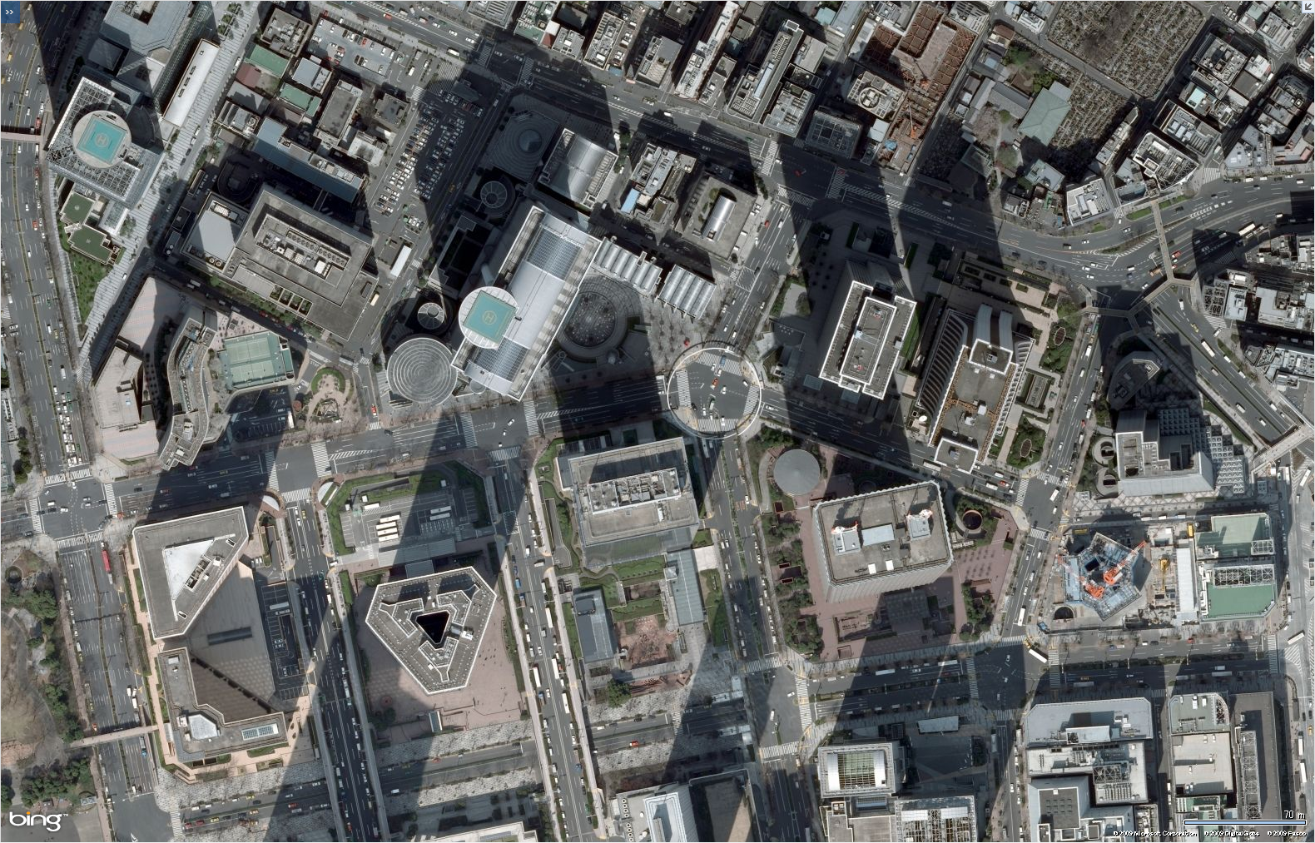
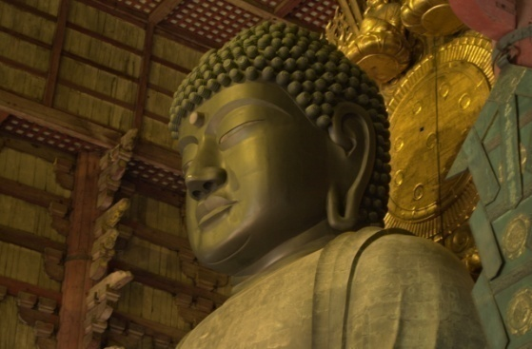
Motivation
Notes:
The purpose of this work is to remove the shadow from images.
Shadows often degrade the visual quality of the images; for example, please look at the left image. You can see the inconsistencies in a stitched aerial photograph. These kind of images take the photographs under different date and time; thus, the orientation of the shadow will differ in the image. In order to generate a realistic map of the city, the shadow should be detected and be removed.
Another example is shown in the right image. In order to capture a clear texture of the object for 3D digital archiving, the shadow should be removed.
Because shadows in an image reduce the reliability of many computer vision algorithms, such as shape-from-X, image segmentation, object recognition, and tracking, we aim to remove the shadow from a single image.
Image courtesy, from left to right.
Image taken from Bing Maps from Microsoft.
Image taken by the laboratory member of the third author, Katsushi Ikeuchi.

Slide 3


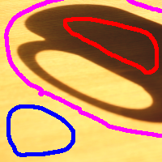
Prior work
multiple
Weiss 01; Matsushita et al. 04
single
automatic
Finlayson et al. 04; Fredembach & Finlayson 06;
Tappen et al. 05; Baba et al. 04; Arbel & Hel-Or 07;
Nielsen & Madsen 07
interactive
Wu et al. 07
Notes:
Due to the importance of the shadow removal, many researchers involved in this research theme.
Prior works can be categorized into two approaches; one uses multiple images as input and the other uses single image as input.
Multiple images give a rich information for removing the shadow; however, taking multiple images is nuisance task.
Recently, many researchers proposed the methods which can be applied to a single image.
Most of these existing methods automatically remove the shadow.
On the other hand, there is a method which makes full use of user supplied hints.
Because the human intelligence is higher than the current artificial intelligence, the user interaction gives quite rich information.
As is done by Wu et al, we also use user interaction in order to successfully remove various types of shadows which appears in various situations.
Image courtesy.
Image taken by the first author, Daisuke Miyazaki.

Slide 4
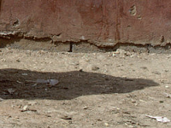
Contribution
Markov random field
Graph cut
Robust
Smoothness
Prior
Hierarchical graph cut
Alpha expansion
Fast
Interactive repairing
User satisfaction
Intuitive
Notes:
The contribution of this work is threefold.
One is that we have defined the cost function properly so that the shadow can be removed robustly.
We solved the problem using the graph cut.
Another contribution is that we have proposed a novel graph cut algorithm, which we call hierarchical graph cut.
The computation time is much faster than alpha expansion algorithm.
The third major contribution is that we have introduced a user interaction framework in shadow removal problem.
Due to the intuitive interface, the users can improve the result until they are satisfied.
Image courtesy.
Image taken from Kodak database.

Slide 5
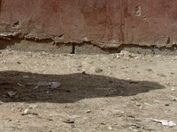
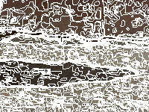
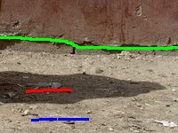
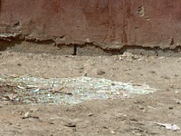
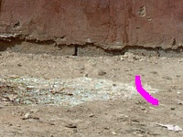
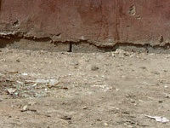
Algorithm flow
1
2
3
Input
Over-segmentation
Lazy snapping
Shadow removal
Initial
Interaction
Output
4
5
6
Notes:
The flow of our system is shown here.
The input is a single image.
First, we separate the image into a number of small regions.
These small regions are used for speed-up the computation for succeeding region segmentation stage and initial shadow removal stage.
Next, at the region segmentation stage, the user separates the image into shadow region, non-shadow region, and non-computation region.
In this image, the red stroke specifies the shadow region, the blue stroke specifies the non-shadow region, and green stroke specifies the region which should not be used for the computation.
At the initial shadow removal stage, the shadow is removed using the default parameters.
The default parameters cannot remove the shadow in enough quality; so, after that, user can repair the output image.
The users can improve the result until they are satisfied; and finally, we obtain the shadow removal image.
Now, I will explain the detail of the algorithm in the succeeding slides.
Image courtesy.
Image taken from Kodak database.

Slide 6
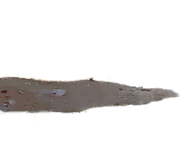
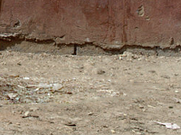
Shadow matte
Solve
Prior of shadowless image
Prior of shadow image
Smoothness of shadowless image
Smoothness of shadow image
Notes:
First, I show the image formulation of the problem.
The input image "I" can be decomposed into the shadow image beta and the shadowless image F.
Beta and F are inter-dependant; that is, if we estimate beta, then we know F at the same time.
We solve this decomposition problem by defining 4 terms for cost function.
Here is the 4 terms used for cost function: prior of shadowless image, prior of shadow image, smoothness of shadowless image, and smoothness of shadow image.
The overall cost will be the weighted sum of these terms.
Now, I will explain each term one by one.
Image courtesy.
Image taken from Kodak database.

Slide 7
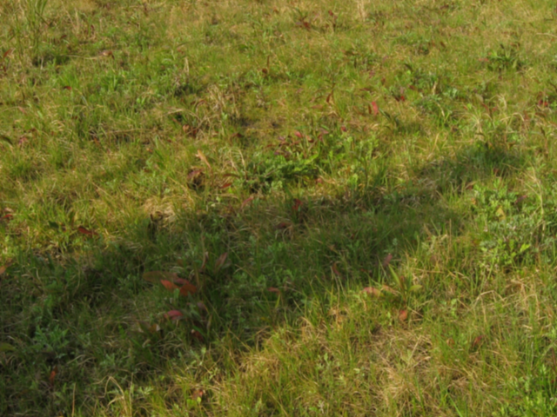
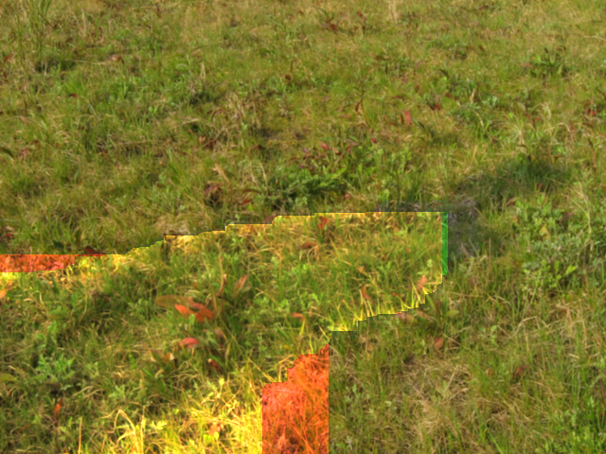
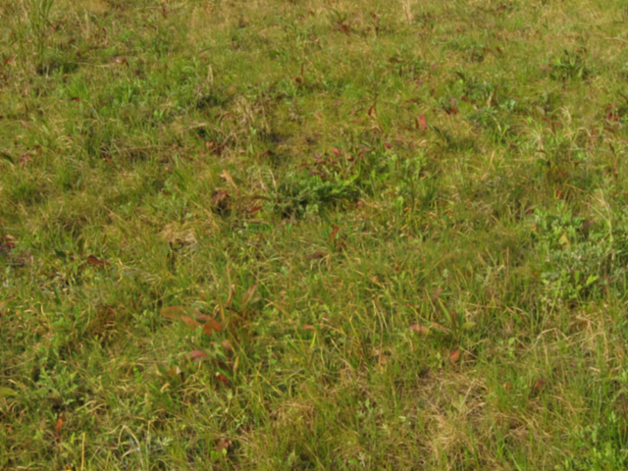
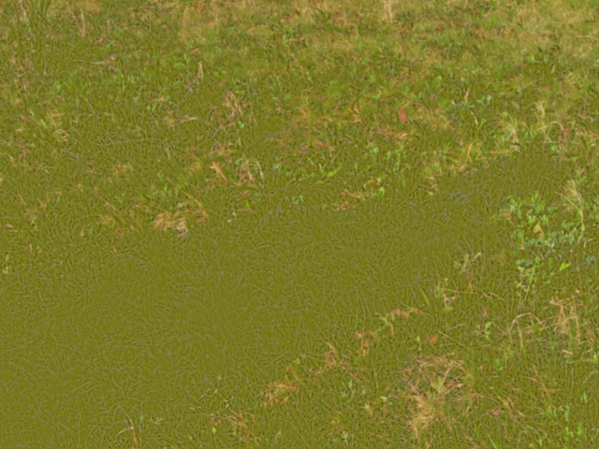
Prior of shadowless image
Likelihood P
small
appropriate
large
Notes:
The first cost term is the prior of shadowless image.
Because we specified the shadow region and the non-shadow region, we can use it as a strong clue.
What we want to do here is to make the color distribution of the shadow region become similar to the color distribution of the non-shadow region.
So, we use the histogram of the pixel brightness of non-shadow region as a prior.
The example of how this cost term works is shown in the bottom.
If we only use this term, the color of result image will be uniform as shown in the right image.
If the weight of 4 cost terms is well-balanced, we can get a good result as shown in the middle image.
If we don't use this term, the color of the result can be arbitrary, and yields bad result as shown in the left image.
Image courtesy.
Image taken by the first author, Daisuke Miyazaki.

Slide 8
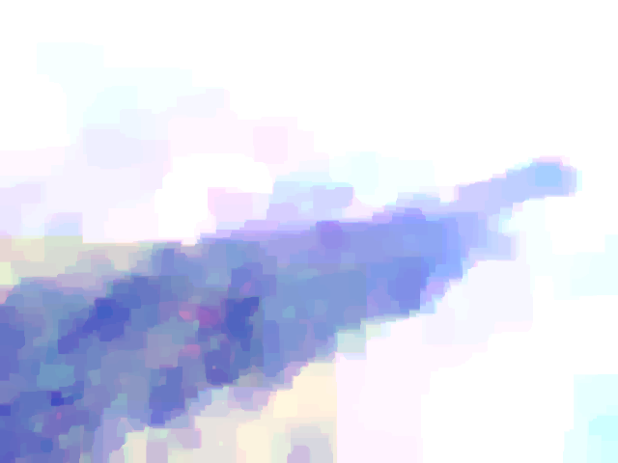
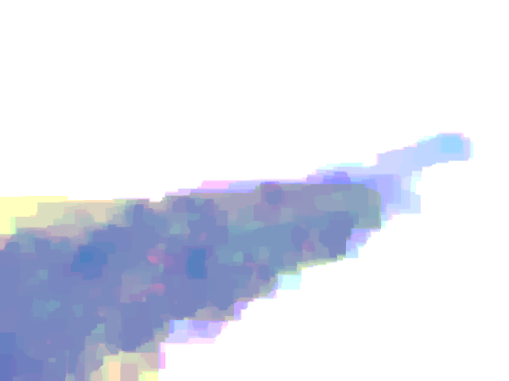
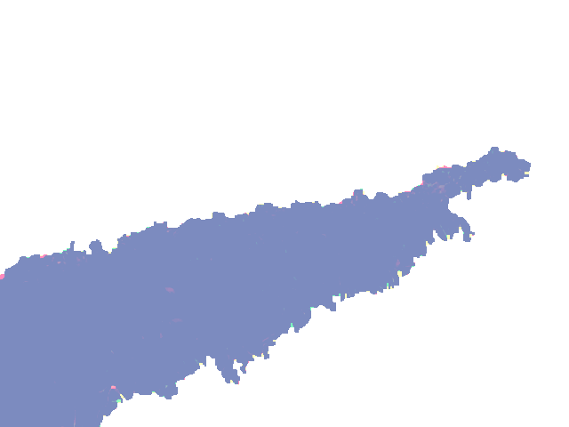
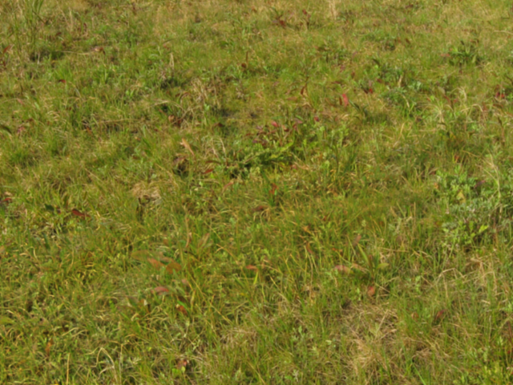
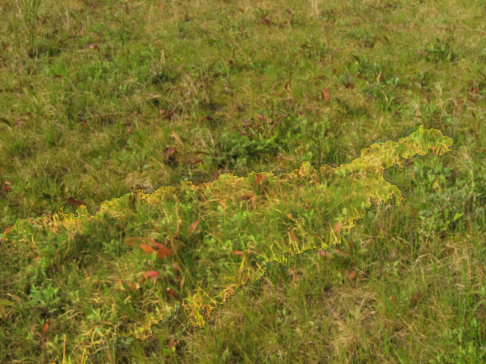
Prior of shadow image
L2-Norm
L1-Norm
L0.7-Norm
small
appropriate
large
Notes:
The second cost term is the prior of shadow image.
Because we specified the shadow region and the non-shadow region, we can calculate the ratio of the average pixel brightness between the shadow region and non-shadow region.
Here, the ratio is represented by beta_zero.
The shadow density in most part of the image varies from beta_zero to 1.
Here, the shadow density 1 means the non-shadow region.
In most pixels, the shadow density equals to either beta_zero or 1.
So, we set the power of 0.7 to the difference term.
The example of how this cost term works is shown in the bottom.
If we only use this term, the shadow density takes only two kinds of values, beta_zero or 1, and the shadow boundary will not be smooth.
If we don't use this term, the shadow density can be arbitrary, and yields bad result as shown in the left image.
Image courtesy.
Image taken by the first author, Daisuke Miyazaki.

Slide 9
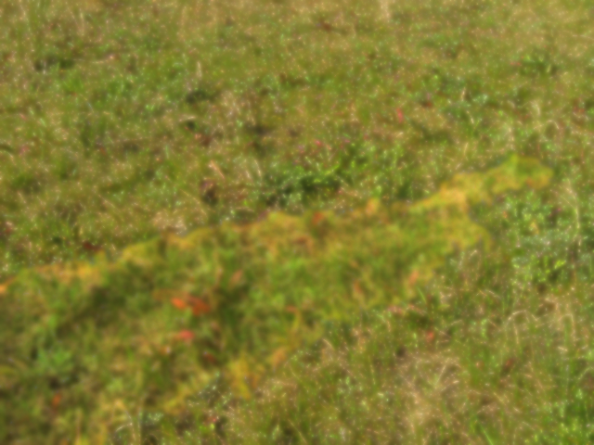
Smoothness of shadowless image
small
appropriate
large
Notes:
The third cost term is the smoothness of shadowless image.
If we use this term, the shadowless image will be smooth as shown in the right image.
If we don't use this term, the shadowless image will be sharp.

Slide 10
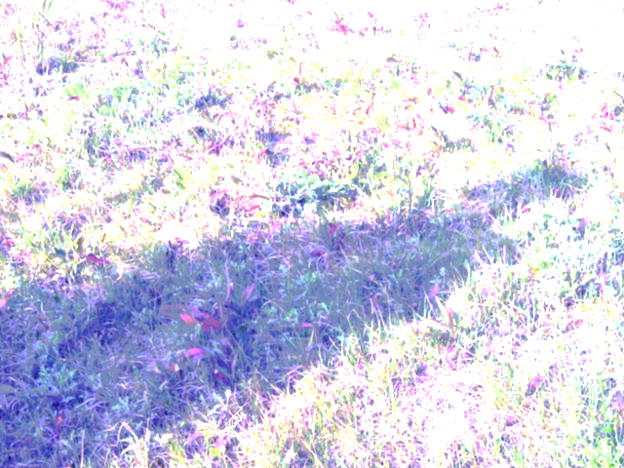

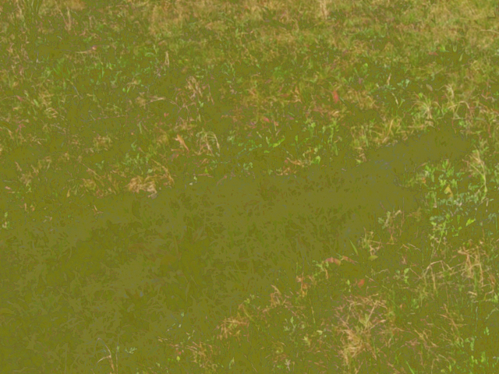
Smoothness of shadow image
small
appropriate
large
Notes:
The fourth cost term is the smoothness of shadow image.
If we use this term, the shadow density will be uniform; in this example shown in the right image, the shadow density of all pixels became 1.
If we don't use this term, the shadow density can be arbitrary, and yields bad result as shown in the left image.

Slide 11
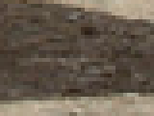
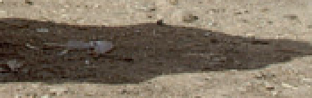

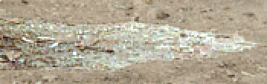

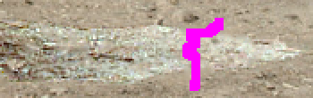

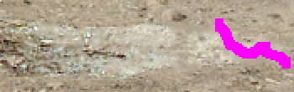

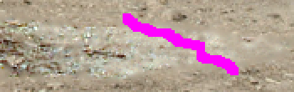
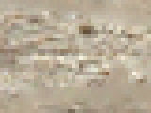
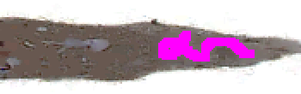
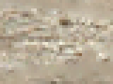
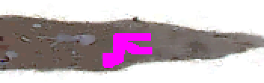
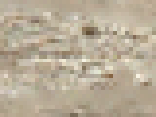
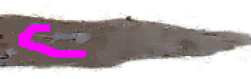
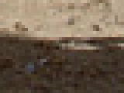
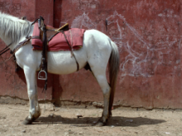
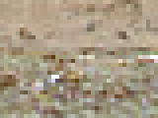
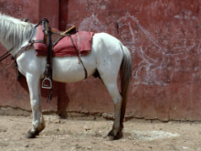
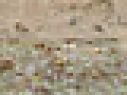

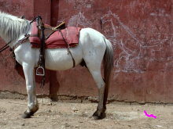

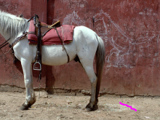
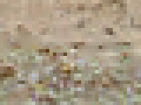
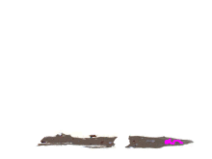
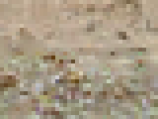
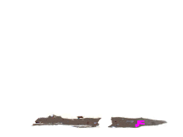


Interactive parameter optimization
Init
Initial
1st
2nd
3rd
4th
5th
6th
0.25
0.7
0.25
1
0
0.4
0
0
Prior
shadowless
Prior
shadow
Smoothness
shadowless
Smoothness
shadow
Notes:
I have expalined the 4 terms used in the cost function: prior of shadowless image, prior of shadow image, smoothness of shadowless image, and smoothenss of shadow image.
A good cost function will be obtained if we propoerly calculate the weighting sum of these terms.
The weight for each term is automatically calculated by the software using the user-supplied hints.
Here is one example of how the system works.
This is the input image.
The weight for each terms are shown in the bottom.
Using the default weights for initial guess of the shadowless image, there would be some defects in some parts.
So, the user draw a magenta stroke where the defects appear.
The software automatically modifies the weight so that the result will be much smoother in the user-specified area.
In this case, the weight for the shadowless prior and the shadowless smoothness increased; that is, the shadowless image will be much smoother.
On the other hand, the weight for the shadow prior decreased.
The weight for the shadow smoothness is always kept to 1 for normalization of each weight.
If the user is still not satisfied, the user can add more strokes: this is the 2nd stroke, and this is the 3rd stroke.
The user can not only make the shadowless image smoother but also make the shadow image smoother, as is shown in this 4th stroke.
This is the 5th stroke, this is the 6th stroke, and if the user is satisfied with this result, we obtain the final result of the shadowless image.
Image courtesy.
Image taken from Kodak database.

Slide 12
Approach based on alpha expansion
Alpha expansion
Hierarchical graph cut
1
5
1
5
3
3
1
5
1
5
1
5
2
alpha=2
3
2
1
5
2
4
1
3
alpha=2,4,...
1
5
2
2
4
4
1
5
alpha=4
3
4
5
Notes:
The explanation about shadow removal is over, and I will explain our novel graph cut method in the succeding slides.
We call this method hierarchical graph cut.
Suppose that we have an image with label 1, 3, and 5.
Alpha expansion changes the label one by one for each graph cut; for example, in this case, the graph cut chnages the label to 2 or leave it to be the same.
On the other hand, our hierarchical graph cut changes the label to 2, 4, 6, etc, or leave it to be the same for each graph cut.
This modification speeds up the computation.
I will explain the detail in the succeeding slides.

Slide 13
Hierarchical structure
20
32
16
32
48
16
48
8
16
24
32
40
48
56
16
32
48
8
24
40
56
8
16
24
32
40
48
56
Notes:
This trilateral tree represents the hierarchical structure of the labels.
This slide shows the case where the labels varies from 0 to 63.
Suppose that the current label is 16 for a certain pixel.
The graph cut compares whether the label 16 should be changed to 8 or the label should remain the same 16.
Next, the graph cut compares whether the label 16 should be chnaged to 24 or remain the same 16.
After that, the computation goes down to the lower level.
(click)
If the current label is 20 for a certain pixel, first the graph cut compares with 32, next 16, and so on.

Slide 14
Graph construction example
α
p
a
q
β
Notes:
This slide shows one example of graph construction.
Please refer to the paper for the whole definition of the graph construction.
In this slide, p and q represents the neighboring pixels, alpha and beta represents the labels, and "a" is an auxilary node added to set the weight of the edges properly.
The red lines represent the 4 possible cuts, and the formulas on the right represents each cut cost.
D represents the data term, and V represents the smoothness term.
The data term is set properly: This cut represents the cost if the label of pixel p is set to be alpha_p and the label of pixel q is set to be alpha_q, this, beta_p and alpha_q, alpha_p and beta_q, and beta_p and beta_q.
The smoothness term of the topmost and the bottommost cuts is also set properly.
But it is difficult to set the correct cost for the cut when the cut crosses through the middle edge.
Suppose that the case when this term is positive.
In this case, the cost function is properly set, since these terms are canceled; and here, the smoothness term of beta_p and alpha_q is left alone.
But if it is negative, the cost function is not properly set: V beta_p beta_q is set instead of V beta_p alpha_q.
Luckily, this modification is as best approximation as possible, which I explain in the next slide.
Due to the algorithm shown in the next slide, beta and alpha is as closest as posibble, so this graph construction gives an enough good approximation.

Slide 15
Algorithm
Alpha expansion
Hierarchical graph cut
A = {0, 1, 2, ..., 63}
for i = 0 to 63 do
  for all nodes&edges do
    add nodes&edges using &
  solve max-flow/min-cut problem
Iterate 2 until convergence
A = {{0}, {32}, {16}, {48},
{8, 40}, {24, 56},
{4, 20, 36, 52}, {12, 28, 44, 60}, ...,
{3, 7, 11, ..., 63}}
for i = 0 to 11 do
  for all nodes&edges do
    add nodes&edges using &
  solve max-flow/min-cut problem
Iterate 2 until convergence
Notes:
For the alpha expansion algorithm, the label from 0 to 63 is used for alpha for each iteration.
On the other hand, our algorithm only needs 12 iterations.
The hierarchical structure of the labels are stored in "A".
Label alpha is the label selected from "A", and label beta is the current label of each pixel.
For each pixel, the label alpha which is the closest to the label beta is chosen.
Due to this algorithm, the graph construction of previous slide gives a good approximation.
And due to the hierarchical structure of label space, the computation time of hierarchical graph cut is much faster than alpha expansion.

Slide 16
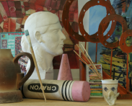
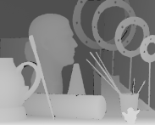
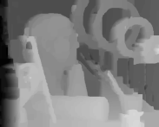

















Output of Hierarchical graph cut
Stereo
matching
[Art]
Stereo
matching
[Laundry]
Image
restoration
Shadow
removal
Input
Ground truth
Ishikawa 2003
α expansion
Hierarchical cut
Notes:
Before showing the shadow removal results, I will show the hierarchicla graph cut results first.
These 2 rows show the stereo results, this row shows the denoising result, and this row shows the shadow removal result.
The columns represent input, true value, Ishikawa 2003 results, alpha expansion results, and our hierarchical graph cut results.
Note that the results look very similar for every methods.
Image courtesy, from top to bottom.
Image taken from Middlebury stereo page.
Image taken from Middlebury stereo page.
Image taken from SIDBA.
Image taken by the first author, Daisuke Miyazaki.

Slide 17
Speed of hierarchical graph cut
 | Stereo matching [Art] | Stereo matching [Laundry] | Image restoration | Shadow removal
Speed-up | ×6.8 | ×11.4 | ×16.6 | ×3.4
Error difference | +4.6% | +3.0% | -0.4% | +0.0%
Hierarchical graph cut
Alpha expansion
1.1×10⁷
1.7×10⁶
Energy
Energy
0
1.5×10⁶
[sec]
250
Iteration
7
Notes:
The detail of the result is shown here.
This row represents that the computation time of our hierarhcical graph cut is 3 times to 16 times faster than that of alpha expansion.
This row shows that the result of our hierarchical graph cut is almost the same as the alpha expansion, or is worse than the alpha expansion.
You can see in the right image that the error value of alpha expansion is lower than the error value of hierarchical graph cut.
Due to the approximation of the algorithm, the alpha expansion often produces better results than our method.
This point in the left image represents the error value of the block matching result of stereo matching.
Comparing with the error of block matching, the difference between the alpha expansion error and the hierarchical graph cut error is indistinguishable; that is, the precision of our method is almost the same as the alpha expansion.
The horizontal line here represents the computation time: You can see that our method is quite faster than alpha expansion.

Slide 18






Incremental improvement
Input
Truth
Finlayson 2004
Wu 2007
Initial
Interactive
[Ours]
Finlayson 2004
Error
Wu 2007
Ours
Number of strokes for parameter optimization
50
Notes:
Next, we show the shadow removal results.
This is the input, true value, Finlayson 2004 result, Wu 2007 result, our initial guess, and our final result.
Please see the blue line.
The error value decreases while the user adds the strokes.
Because the human intelligence is much higher than the current artificial intelligence, the user supplied hints give a very strong clue for shadow removal; and the user can obtain a better result than existing methods.
Image courtesy.
Image taken by the first author, Daisuke Miyazaki.

Slide 19












Natural images
0 strokes (param. opt.)
1.4 sec × 1 strokes
1.2 sec × 4 strokes
2.1 sec × 6 strokes
Notes:
These are the results applied to natural images.
The left image successfully removed the shadow with default parameters, so the user didn't need to add the magenta strokes.
The other image required a certain number of strokes to improve the output image.
The computation time shown here is calculated with 3GHz desktop PC.
Image courtesy, from top to bottom.
Image taken from Kodak database.
Image taken from Kodak database.
Image taken by the first author, Daisuke Miyazaki.
Image taken from Kodak database.

Slide 20












Natural images
1.5 sec × 8 strokes
2.0 sec × 12 strokes
1.9 sec × 15 strokes
1.5 sec × 2 strokes
Notes:
Another results are shown here.
The shadow is successfully removed.
Note that the shadow to be removed is up to the user.
The shadow of the cracks is not removed, the shadow of the leg is not removed, and the shadow of the statue is not removed.
If the user specifies these regions, the shadow of these regions will be also removed.
In the right image, the leg of the bird also disappears because the color of the shadow and the leg is very similar.
This is always the problem not only in our method but also in other existing methods.
Image courtesy, from top to bottom.
Image taken from Kodak database.
Image taken from Kodak database.
Image taken from Kodak database.
Image taken by the first author, Daisuke Miyazaki.

Slide 21












Natural images
2.0 sec × 26 strokes
5.8 sec × 27 strokes
6.3 sec × 32 strokes
2.8 sec × 40 strokes
Notes:
Here is the result of complex scences.
The gradually changing shadow of glass is successfully extracted.
But because of its complexity, the user needs many strokes to extract the shadow.
Image courtesy, from top to bottom.
Image taken from Kodak database.
Image taken by the first author, Daisuke Miyazaki.
Image taken by the first author, Daisuke Miyazaki.
Image taken by the first author, Daisuke Miyazaki.

Slide 22




Aerial images
Notes:
Our method also successfully removes the shadow of aerial image.
Many strokes are added and the software ran many times due to its complex scene; but after a great effort, we can obtain a good result.
These results show that our method is quite useful in many application fields.
Image courtesy.
Image taken from Bing Maps from Microsoft.

Slide 23
Conclusions
Solved by graph cut
Parameter adjustment
Cost function
User interaction
Hierarchical graph cut
Fast computation
Notes:
Now I conclude my talk.
1. We have properly defined the cost function so that the shadow can be robustly removed.
2. We allow the user to interact to the system so that the user can obtain a satisfactory result by improving the image.
3. We have proposed a hierarchical graph cut which is much faster than alpha expansion.
Image courtesy.
Image taken from Kodak database.

Slide 24



Discussions
Cost function
Is it difficult for soft shadow?
User interaction
Is automatic-approach better?
Hierarchical graph cut
Does it fall into local minimum?
Notes:
Of course our method is not perfect, and there might be a rich room for improvements.
In most cases, the user strokes are added to the shadow boundary.
The default parameters are set to be suitable for removing hard shadow.
Because the parameters for soft shadow is difficult to find, we force the user to find the better parameters for soft shadow.
Increasing the robustness to the soft shadow is one of the important future task.
Because the human intelligence is high, using the user supplied hints produces a very good results; but drawing many strokes is somewhat irritating.
Automatic computation with high quality results is an open problem for shadow removal problem.
The precision of hierarchical graph cut is almost the same as alpha expansion, but our method is often slightly worse than alpha expansion.
For example, if the local minimum is in the red line, and the global minimum is in the blue line, our method falls into local minimum.
The tradeoff between the precision and the speed should be greatly considered for prospective graph cut methods.
Image courtesy.
Image taken by the first author, Daisuke Miyazaki.

Slide 25
Daisuke Miyazaki 2009
Creative Commons Attribution 4.0
International License.
http://www.cg.info.hiroshima-cu.ac.jp/
Daisuke Miyazaki, Yasuyuki Matsushita, Katsushi Ikeuchi, "Interactive shadow removal from a single image using hierarchical graph cut," Lecture Notes in Computer Science (Proc. Asian Conference on Computer Vision), vol. 5994, part 1, 2009.
Notes:
And that's all for my talk.
Thank you very much.

