Slide 1
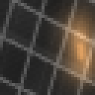
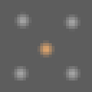
Specular removal of monochrome image using polarization and deep learning
Daisuke Miyazaki & Naoto Yoshimoto
I_{max}
I_{avg}
I_{min}
Hiroshima City University
I_{max}
Pseudo red
R
Gray
I_{avg}
Pseudo green
I_{min}
Pseudo blue
I_{max}
I_{max}
Specular
Specular
I_{min}
Pseudo color
Diffuse reflection
Diffuse
I_{min}
Diffuse
Color image
G
Grayscale image
32×32@3
32×32@32
32×32@16
32×32@16
32×32@16
32×32@32
32×32@3
Incident
light
Specularly
reflected
light
Diffusely
reflected
light
16×16@16
Unpolarized
Unpolarized
16×16@16
16×16@32
16×16@16
16×16@16
16×16@32
16×16@16
Partially
polarized
Skip connection
3×3 Conv2D
Dropout
2×2 Max pooling
8×8@16
8×8@32
8×8@16
Air
3×3 TransposedConv2D
3×3 TransposedConv2D (2 strides)
Object
Unpolarized
Partially
polarized
(w/ polarization)
(w/o polarization)
Pigment
Input
Output
Truth
Input
Output

Slide 2
Overview
Specular reflection removal is easy if we can use color image.
However, it is difficult for grayscale image.
In order to solve the problem, we use polarization.
We use the phenomena that specular reflection polarizes while diffuse reflection doesn't polarize.
Polarization solely does not solve the problem, thus, we also use deep learning network.

Slide 3
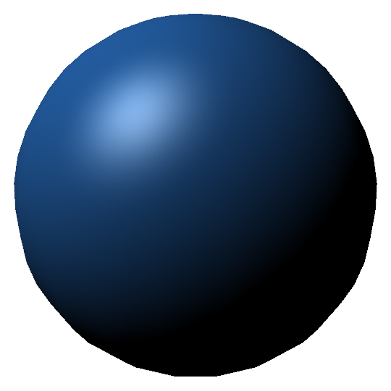
Specular removal
Specular reflection
Diffuse reflection

Slide 4
Color vs Gray
R
Gray
I_{max}
I_{max}
Specular
Specular
I_{min}
I_{min}
Diffuse
Diffuse
G
Specular removal
of color image
Specular removal
of grayscale image

Slide 5
Incident
light
Specularly
reflected
light
Unpolarized
Diffusely
reflected
light
Partially
polarized
Unpolarized
Air
Object
Partially
polarized
Unpolarized
Pigment
$$I_{max}=I_{s,max}+I_{d}$$
$$I=I_{s}+I_{d}$$
$$I_{min}=I_{s,min}+I_{d}$$

Slide 6
Pseudocolor input image
$$\left(R,G,B\right)=\left(I_{max},I_{avg},I_{min}\right)$$
I_{max}
I_{avg}
I_{min}
I_{max}
Pseudo red
I_{avg}
Pseudo green
I_{min}
Pseudo blue
Pseudo color
Diffuse reflection
$$\left(I_{s,max}+I_{d},I_{avg}+I_{d},I_{min}+I_{d}\right)$$
$$\left(I_{d}, I_{d}, I_{d}\right)$$

Slide 7
U-net
Input image
Diffuse reflection image
32×32@16
32×32@3
32×32@32
32×32@16
32×32@16
32×32@32
32×32@3
16×16@16
16×16@16
16×16@32
16×16@16
16×16@16
16×16@32
16×16@16
Dropout
8×8@16
8×8@32
8×8@16
Skip connection
3×3 Conv2D
3×3 TransposedConv2D
2×2 Max pooling
3×3 TransposedConv2D (2 strides)

Slide 8
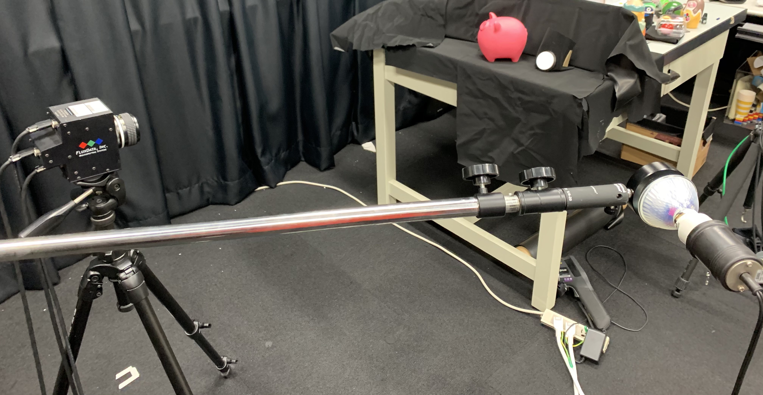
Experimental setup

Slide 9
Training set: Proposed method
Input image (Diffuse + Specular) Pseudo-color w/ polarization
Output image (Diffuse)

Slide 10
Loss
0.02
Loss
0
Epoch
40

Slide 11
Result: Proposed method
Input image
Output image
Ground truth

Slide 12
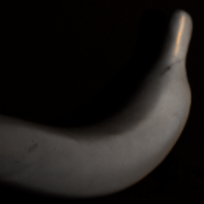
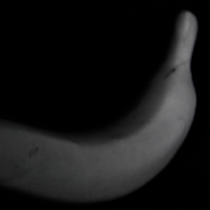
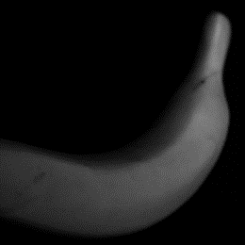
Result: Proposed method
Input image
Output image
Ground truth

Slide 13
Training set: Ablation study
Input image (Diffuse + Specular) w/o polarization
Output image (Diffuse)

Slide 14
Result: Ablation study
Input image
Output image
Ground truth

Slide 15
Benefit of polarization
With polarization
Without polarization
Input image
Output image

